Slide 1
Comparative Cultural Analysis of China and Britain – Selected Genres of Popular Music, Film, Television and Print Media Discussion on Globalization and Westernization
GEL504 - Prepared by Piers Kuan, Week 5

Slide 2
Comparative Cultural Analysis
Comparative Cultural Analysis is a core methodological study that provides students with the knowledge and tools necessary for conducting cultural analysis, understood as the critical study of cultural objects while relating these objects to the present.
Major elements include “The Decolonization of the Study of the Culture”, “The Colonial Attitude”, “The Indigenous Knowledge”
Source: https://www.academia.edu/28690359/Contemporary_Comparative_Cultural_Studies_Theory_Contexts_and_Trends

Slide 3
The Decolonization of the Study of the Culture
Colonialism: “Colonial Habits and Attitudes” are rampant in one’s culture when a country or city has been conquered by another country which brings its own culture to the colonial place that lasts for a long period of time. Such habits and attitudes will linger and erodes the traditional / indigenous culture. Take Hong Kong as an example.
Decolonization: Removal of such “Colonial Habits and Attitudes” out of political, practical and/or other concerns in order to retain or restore the indigenous culture. Take Macau as an example.
Can we suggest how we can apply the concept of “Colonization” and “Decolonization” to under the popular culture of China and Britain?

Slide 4
The Colonial Attitude
For example, The Colonial Attitude is used for the analysis of the popular culture of Hong Kong and Britain.
Locally produced films of Hong Kong in or before 1997 show lots of traces of colonialism in their playwrights such as “事頭婆” (The Queen Elizabeth of Britain” and other British elements are always mentioned in the film series, Aces go places” (最佳柏檔). Citizens of Hong Kong at that time showed good respect to the British regime and did not talk too much about the affairs of mainland China.
Can you brainstorm some similar films to show the colonial attitude of a place?

Slide 5
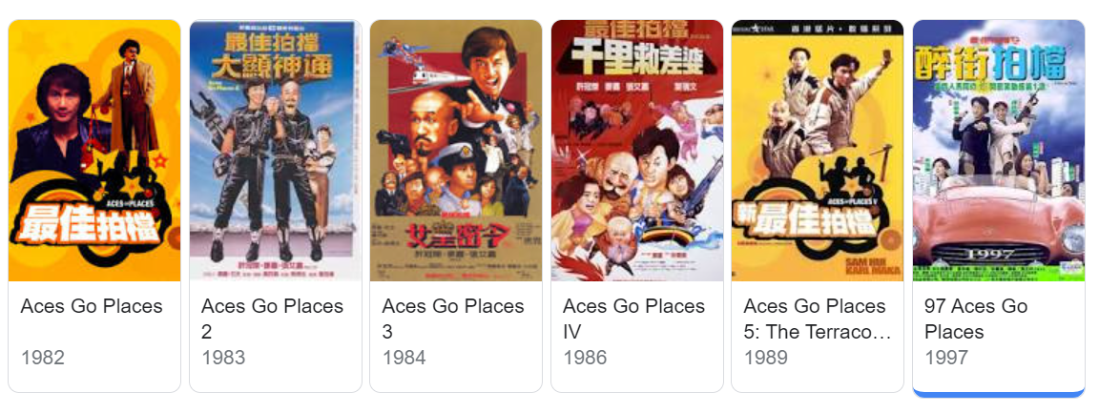
The Series, “Aces Go Places” by Sam Hui and Others
https://www.youtube.com/watch?v=gQEzfkFvTWg
https://www.youtube.com/watch?v=mhxnkehHscQ

Slide 6
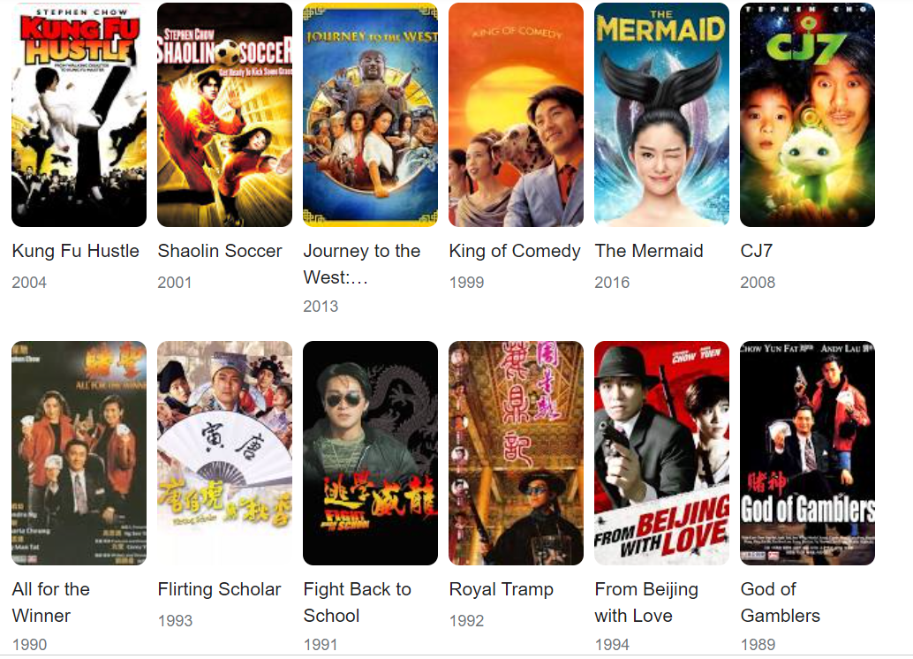
Stephen Chow’s Film Series

Slide 7

Donnie Yen’s Film Series: Ip Man

Slide 8
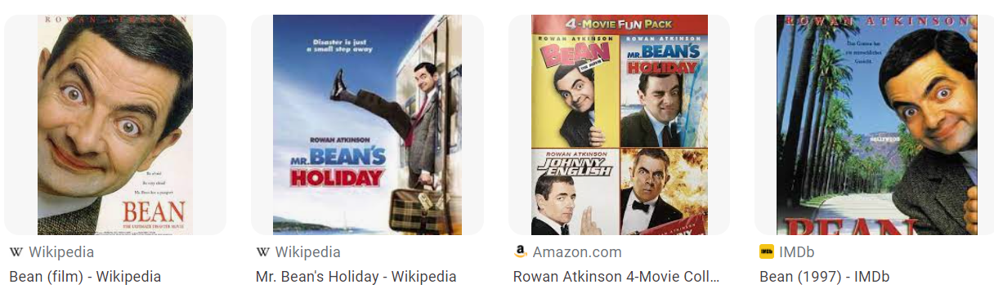
Mr. Bean’s Film Series

Slide 9
The Indigenous Knowledge by UNESCO
Local and indigenous knowledge refers to the understandings, skills and philosophies developed by societies with long histories of interaction with their natural surroundings. For rural and indigenous peoples, local knowledge informs decision-making about fundamental aspects of day-to-day life.
This knowledge is integral to a cultural complex that also encompasses language, systems of classification, resource use practices, social interactions, ritual and spirituality.
These unique ways of knowing are important facets of the world’s cultural diversity, and provide a foundation for locally-appropriate sustainable development.
Source: UNESCO at https://en.unesco.org/links

Slide 10
The Indigenous Knowledge by J. Mistry (2009)
J. Mistry, in International Encyclopedia of Human Geography, 2009
Indigenous knowledge is defined as knowledge which is spatially and/or culturally context specific, collective, holistic, and adaptive.
Although it was previously largely ignored in the fields of development and conservation, indigenous knowledge is currently living a revival and its incorporation into development projects is seen as essential.
However, there are many issues surrounding the recording of indigenous knowledge and its transference to other localities and contexts.
There are debates on the extent to which indigenous knowledge is useful and to whom, outside the situation within which it was constructed.
Although it is widely recognized that many lessons could be learnt from indigenous knowledge systems, there is little protection for indigenous knowledge within international law and as such it is vulnerable to abuse and disownment.
https://www.sciencedirect.com/topics/earth-and-planetary-sciences/indigenous-knowledge

Slide 11
Indigenous Knowledge and Traditional Knowledge
Over time, Indigenous peoples around the world have preserved distinctive understandings, rooted in cultural experience, that guide relations among human, non-human, and other-than human beings in specific ecosystems.
These understandings and relations constitute a system broadly identified as Indigenous knowledge, also called traditional knowledge or aboriginal knowledge.
Archaeologists conducting excavations in Indigenous locales may uncover physical evidence of Indigenous knowledge (e.g. artifacts, landscape modifications, ritual markers, stone carvings, faunal remains), but the meaning of this evidence may not be obvious to non-Indigenous or non-local investigators.
Researchers can gain information and insight by consulting Indigenous traditions; these localized knowledges contain crucial information that can explain and contextualize scientific data.
Archaeologists should, however, strive to avoid interference with esoteric knowledges, sacred sites, ritual landscapes, and cultural property.
Research consultation with local Indigenous knowledge-bearers is recommended as a means to ensure ethical practice and avoid unnecessary harm to sensitive sites and practices.
https://repository.upenn.edu/cgi/viewcontent.cgi?article=1172&context=anthro_papers

Slide 12
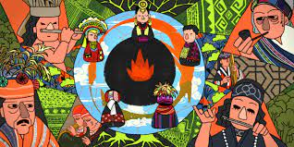
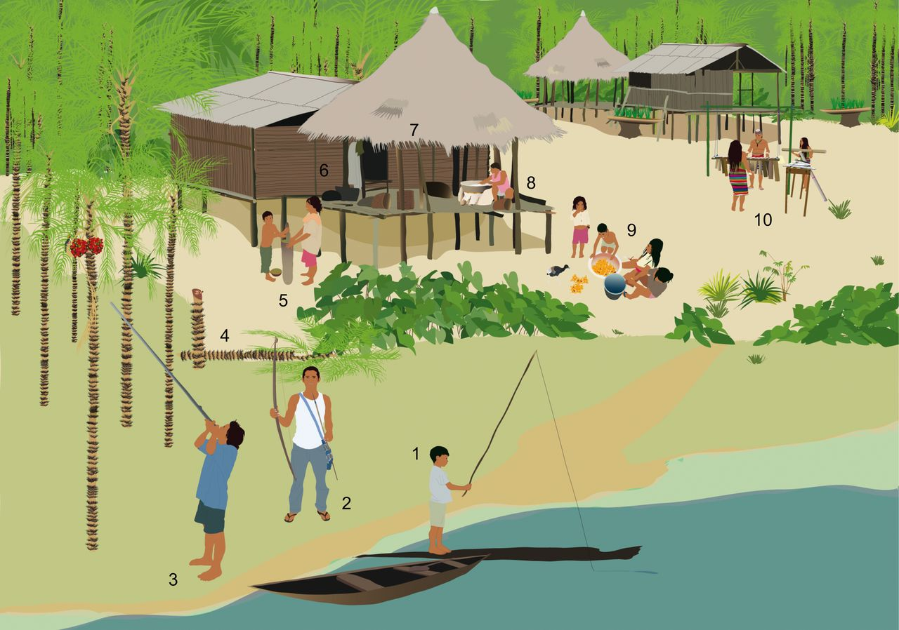
What can you learn from these two pictures?

Slide 13

Videos on IK and TK
https://www.youtube.com/watch?v=kRac1qVrD8k
https://www.youtube.com/watch?v=2mCtpebc_Pg
https://www.youtube.com/watch?v=c-PwEnC-Rj8
https://www.youtube.com/watch?v=WBze1WHZtSM
https://www.youtube.com/watch?v=xlGnve1cjOY

Slide 14
How can we apply IK/TK into the study of the cultural studies?
As the Guidance details, Indigenous Knowledge – also referred to as Traditional Knowledge or Traditional Ecological Knowledge – is a body of observations, oral and written knowledge, innovations, practices, and beliefs that promote sustainability and the responsible stewardship of cultural and natural resources through relationships between humans and their landscapes.
Observations
Oral and written knowledge
Innovations
Practices
Beliefs of Promotion of Sustainability and Responsible Stewardship of Cultural and Natural Resources

Slide 15

Thank you!

